Slide 1

Dereliction mask wearing and the effect of not wearing masks during the pandemic Data visualization

Slide 2
Since the begin of covid 19 there are many people did not believe that face masks will protect us from spread the virus and they under-estimate their role and refused to wearing them and many others who do not take serious and they don’t wear it appropriately, whether they leave their under the chain or uncover their noses or even put on their wrists and usually forgot even when they get into the crowded Places. Masks should cover of both nose and mouth and fit properly under the chin.

Slide 3
Whereas the majority of people who use masks do it correctly, that isn't always the case, though. Many people choose to wear their masks down so that only their mouth is covered and their nose is revealed. However, this defeats one of the mask's primary functions. Several experts' research has shown that the nose is extremely prone to COVID-19 virus.

Slide 4

The study's goal is to figure out the impacts of masks wearing during the pandemic
My first graph is about how many people from various places say they leave the house wearing a mask in chart was contain twenty one of biggest countries
Always Never

Slide 5
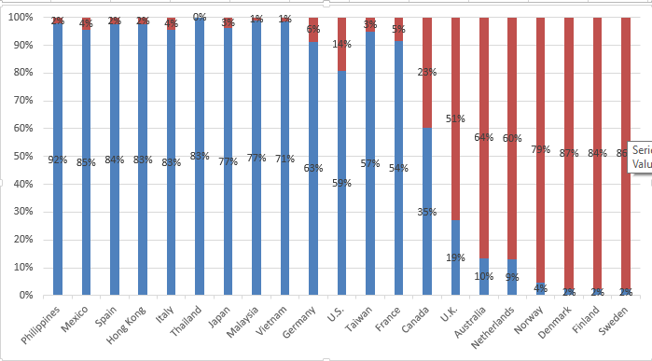

Slide 6
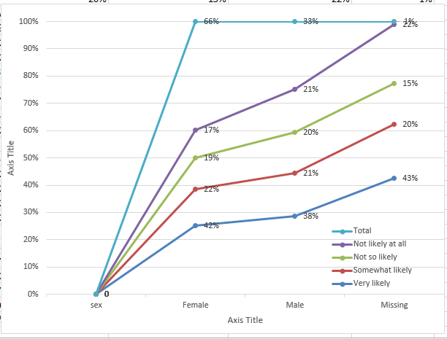
Features of overall average survey respondents according to whether or not they are likely to wear a mask

Slide 7
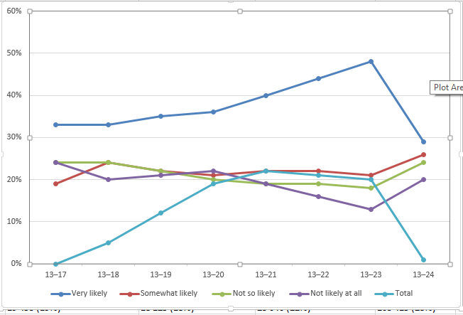

Slide 8
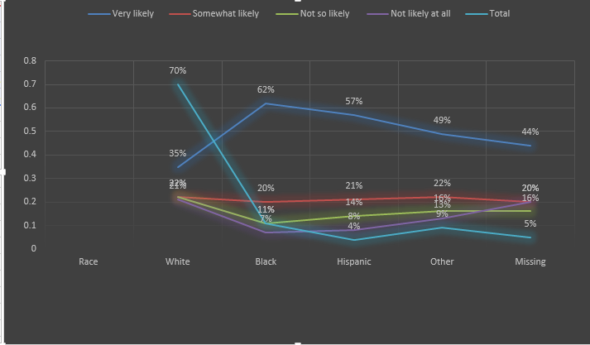

Slide 9
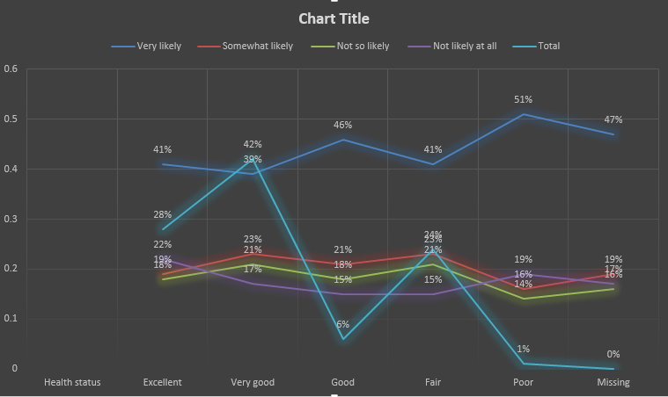

Slide 10
Thank you for listening
Ahmed Elmaloul
16030441006 Mis

